Slide 1
Introduction to 3D Printing (Additive Manufacturing)

Slide 2
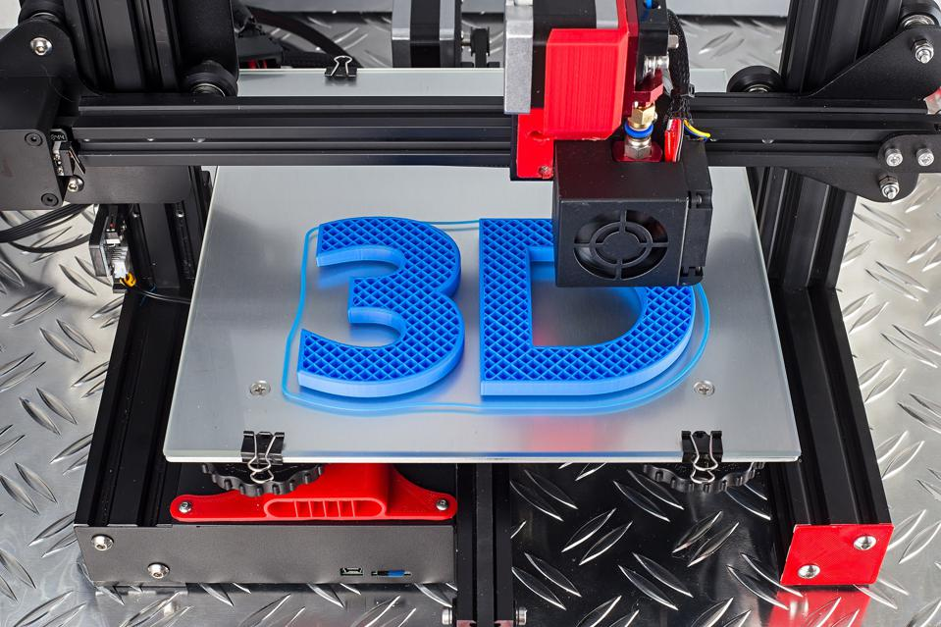
What is 3D Printing & Additive Manufacturing (AM)?
Notes:
3D printing is a manufacturing process that creates three-dimensional objects from a digital design by building up successive layers of material. It has revolutionized the way products are designed and manufactured, offering benefits such as greater customization, faster prototyping, and reduced waste.

Slide 3
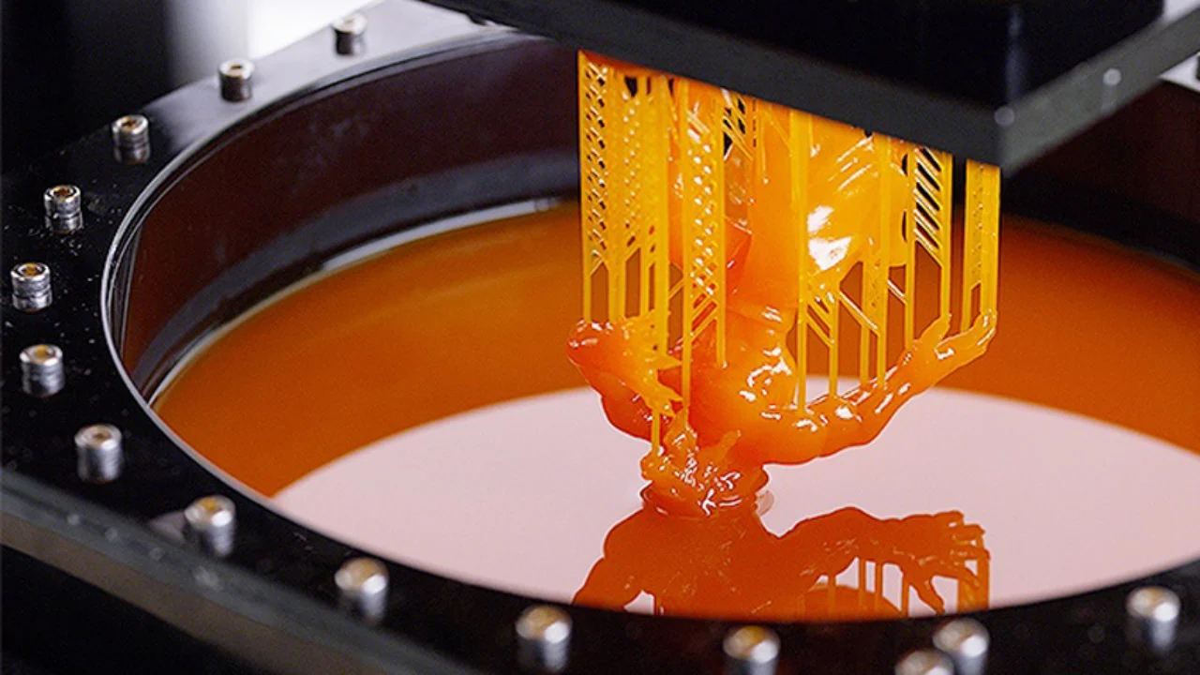
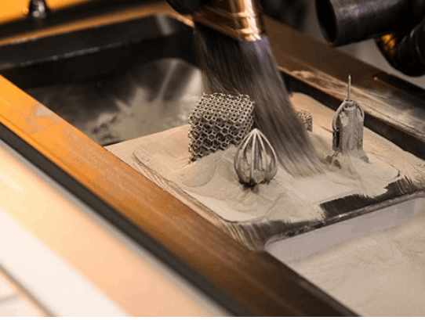
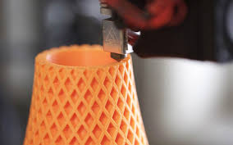
Types of AM technology?
SLA
DLP (Resin Printing)
FDM (Filament Printing)
Laser sintering
Multi jet fusion
We’ll be focusing on FDM technology
Notes:
explain a bit about each type, talk about 1 strength or weakness & show the products
Strengths and weaknesses:
SLA: High accuracy but delicate and slow speeds
DLP: High accuracy but expensive and brittle
FDM: Cheap but low accuracy
Laser sintering: Accurate but very expensive
Multi-jet-fusion - Very fast and precise but only single colour models are possible and surface is often rough

Slide 4
Now we go down to the DT

Slide 5
Components of an FDM Printer & Basic tools

Slide 6

Thingiverse: Find your own 3D model
www.thingiverse.com
Notes:
Thingiverse is an online platform for sharing and downloading 3D printable digital designs. It is a community-driven website where users can upload, share, and collaborate on designs for various 3D printable objects, including toys, gadgets, tools, and more. Search up “low poly pokemons” and choose anything there which you want to model and download it.

Slide 7
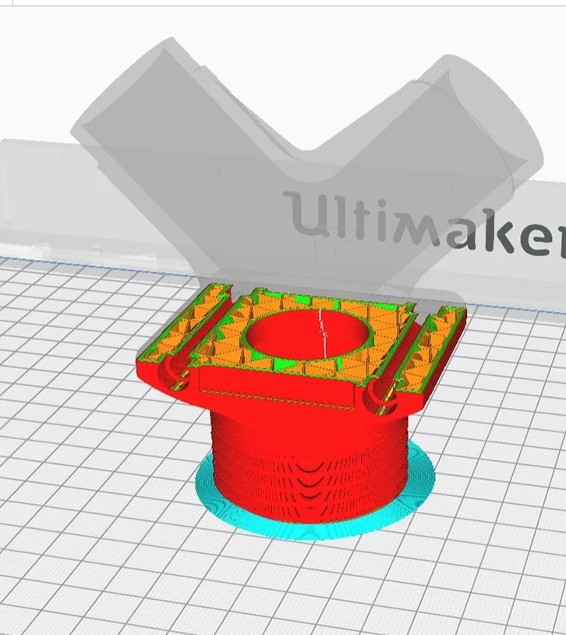
Introduction to Slicer: Cura Ultimaker
What is a slicer?
Introduction to Cura
Notes:
A slicer is a software program that converts a 3D model into a set of instructions that a 3D printer can understand and use to produce a physical object. In other words, a slicer takes a 3D model and slices it into thousands of thin, horizontal layers that the printer can then print layer by layer.
Cura Ultimaker is a popular and free slicer software that is commonly used in the 3D printing industry. It allows users to customize various settings such as layer height, print speed, infill density, and more to achieve the desired print quality and functionality. Cura Ultimaker also provides users with a preview of the sliced model before printing, allowing them to detect and correct any potential errors or issues before printing.

Slide 8
How to Use Cura Ultimaker
Install and open Cura Ultimaker on your computer.
Choose your printer type and adjust printer settings
Import your 3D model file into Cura.
Position, rotate, and scale your model as desired.
Adjust slicing settings.
Preview the sliced model and adjust any settings as necessary.
Save it to your computer as a gcode file
Send your print to Giac, or you can put on the group chat

Slide 9
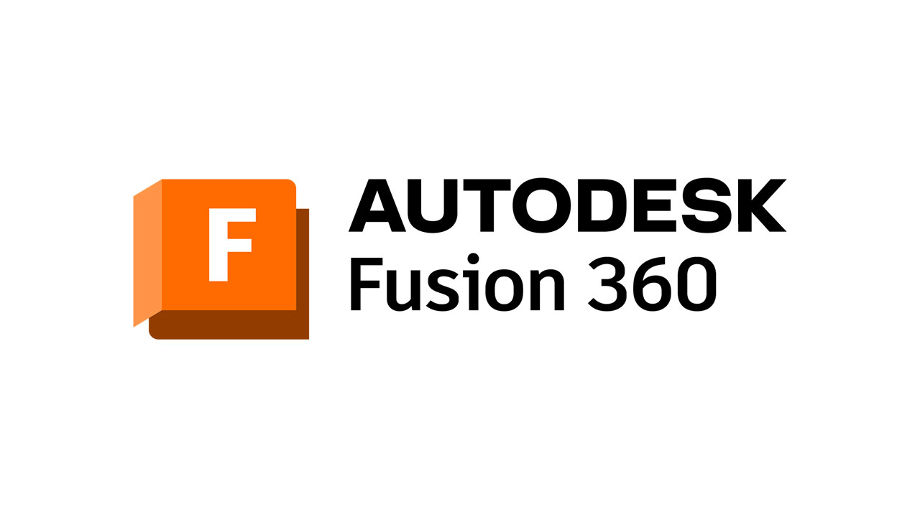
Fusion 360
Remember our very first session with Giac talking about how he used an application called Fusion 360 to model a part of a headphone himself? Well, you guys will now be using this from next week onwards!

